Slide 1
Notes:
Introduce speaker and role at Gen2 – Why are you in their school talking to them?

Slide 2
What you should get out of this session
Find out about apprenticeships and opportunities for sixth form students
Find out about Gen2
Learn about prospective employers who offer apprenticeships
Provide information about potential career options
Understand typical entry requirements
Find out how to apply and the application process

Slide 3
Notes:
Who’s in the audience? Many of you in here now are thinking about your post 16 or post 18 options, and many times it can feel that there are perhaps too MANY options out there. But it’s important that when you are thinking of life after school, you look AT and EXPLORE every single option available for you. And if you are clever, you will also be APPLYING for everything that is out there: give yourself more options to chose from, than none at all. You want to be in the position of results day, where you can run up to your friends, your family, your teachers and say “I’ve got a cracking set of results and I’ve got X amount of options in the table available for me” rather than the opposite of running up to them and saying “I have absolutely no options whatsoever as the 1 thing I’d pinned my hopes on hasn’t materialised”. So that leads us back to the million dollar question: who ARE Gen2?
(feel free to draw on your own personal post 16/18 experiences within this slide but keep them brief)

Slide 4
Notes:
Gen2 are Cumbria’s largest and most popular apprenticeship training provider, particularly in respect to engineering. But we don’t just offer engineering apprenticeships. We offer training in business, IT, nuclear, teaching and project management, with a range of apprenticeships levels from 2 (intermediate/GCSE level) right up to 5/6 (degree level).
We currently deliver to 1,350 young people across Cumbria a year: from Carlisle and Penrith, to Cockermouth and Whitehaven, right down to Barrow and Kendal. We even train apprentices within this area (give example of companies within the area of the school you are in) Check before appointment
But most importantly, Gen2 are an ‘Outstanding’ PRIVATE training provider as rated by Ofsted. That means that the quality of teaching, the level of care, but more importantly, the outcomes of your apprenticeship, are deemed ‘outstanding’ by Ofsted.
As previously mentioned, Gen2 are based throughout Cumbria. We have 5 skills centres across the county including in Carlisle, Workington and Ulverston.

Slide 5
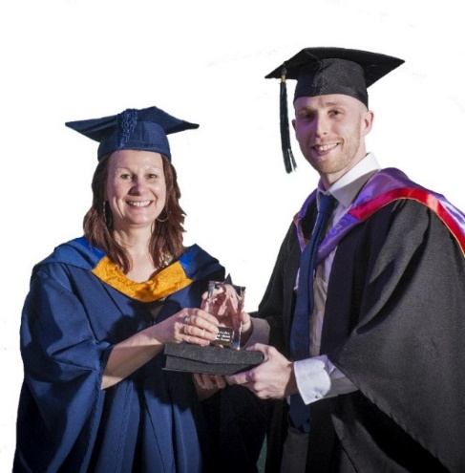
Why Gen2?
‘Outstanding’ Teaching - Ofsted Grade 1
We have established links with key employers and large apprenticeship contracts with Cumbrian organisations
Dedicated mentors and support staff
Excellent pass rates and employment rates
Range of progression opportunities
92.5% of our apprentices enter full time employment (20% above the national average)

Slide 6
Notes:
Whilst these are where our training centres/offices are based, we work closely with over 300 businesses, so you may be based with your employer from Day 1 and only need to come to our training centre one day a week or once every six weeks. It all depends on the requirements of your employer, who will discuss these with you prior to you starting your apprenticeship.

Slide 7
Notes:
These are examples of our training facilities. So if you live in the (name geographical area of the school you are in) your main base for anything will be (name training facility). Our facilities have a great feel to them, and have break out areas for our learners (similar to common rooms or recreational areas), state of the art training facilities like engineering workshops and IT facilities, free WiFi throughout and free on site parking….perfect for once you start earning the big bucks and want to show off your brand new car.

Slide 8
Notes:
So, throughout this presentation we have discussed the fact that we train for over 300 companies: these are just SOME of them. So when you apply to Gen2, your application will go to anyone of these companies IF they are looking to take on an apprentice in the area that you want the apprenticeship in.
Therefore it is important then when you apply, you aim to make yourself as attractive as possible to as many different employers as possible. Because as previously mentioned, where one company may not select you, another company may be desperate for you.
Make sure when you apply with your personal statement & CV that you don’t reference one particular company that you want to work for, as this may impact on your chances of securing an apprenticeship should your application land on another company’s desk.
EMPHASISE THAT BY APPLYING TO ONE COMPANY DIRECT, THEY ARE ONLY APPLYING FOR THAT ONE COMPANY. WITH GEN2, THEY COULD BE CONSIDERED NOT JUST FOR THAT COMPANY, BUT FOR A WHOLE HOST OF OTHERS AS WELL → MORE CHOICE, MORE VARIETY

Slide 9
Notes:
So let’s get down to the important stuff: what is actually involved with an apprenticeship you undertake with Gen2?

Slide 10
What is an apprenticeship ?
Training position to do a skilled job role with an employer
Offered at various levels with different entry requirements
Employers can stipulate specific entry requirements
Lasts from 12 – 60 months dependant on scheme
Includes vocational training “on-the-job” with the employer
Gen2 will monitor and assess your progress against the approved standard for the apprenticeship
You may also carry out an academic qualification with Gen2
Attendance at Gen2 varies according to the apprenticeship and may range from 5 days per week to 2 days per month

Slide 11
More about apprenticeships …
You will be an employee of your organisation for the duration of your apprenticeship which will hopefully lead to a full time staff position on completion.
Gen2 find the employer for you.
The employer will pay for your training (no debt)
The employer will pay you an apprenticeship wage which at present is a minimum of £153 per week based on 37 hours per week but often degree apprentices are paid a higher wage.
The employer will work with Gen2 to provide on-the-job training in-line with the agreed standard for the role

Slide 13
Business and Education Apprenticeships
Business Apprenticeships at Level 2 / 3
Business Administration
Customer Service
IT Digital Technician
Project Management
Education Sector Level 3
Teaching Assistant

Slide 14
Professional & Nuclear Apprenticeships
Professional & Nuclear Apprenticeships at Level 2-4
Civil Engineering
Project Controls
Nuclear specialisms:
Health Physics Monitor
Nuclear Welding Inspection Technician
Nuclear Operator

Slide 15
Craft apprenticeships (Engineering)
Level 2 Craft Apprenticeships – mostly 12 months
Welding, Fabrication & Plating,
Process
Level 3 Craft Apprenticeships - 42 months
Mechanical
Electrical
Design
Machinist
Pipefitting
Welding

Slide 16
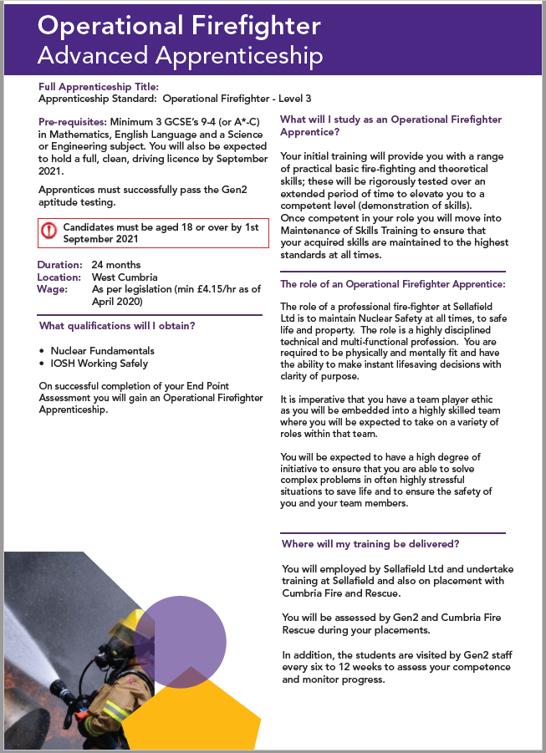
Firefighter Apprenticeships
Level 3 Operational Firefighter Apprenticeship

Slide 18
Notes:
Our Higher Education department was formed in 2005. We, and a large number of the companies we train for, were noticing that young people in Cumbria who wanted to work in industry and gain a degree, were having to move away in order to make this happen. Or they were completing their apprenticeship and had no way of expanding on their education and further themselves. As a result, the county was losing talented and ambitious young people, so we formed this department.
Our Higher Education now trains over 300 students, led by a team of both industry and further education experienced lecturers.
Training for our higher and degree programmes is similar to our intermediate/advanced apprenticeships, in that they are a mixture of ‘on the job’ training and ‘in centre classroom’ learning.
You will be trained using state of the art technology
And best of all, our ENTIRE suite of degree programmes are all validated by The University of Cumbria, for which you’ll get a lovely graduation ceremony in Carlisle Cathedral, and they are all accredited by professional institutes and university partnerships like The University of Manchester and the Society of Engineers.

Slide 20
Applying for Sellafield Ltd?

Slide 21
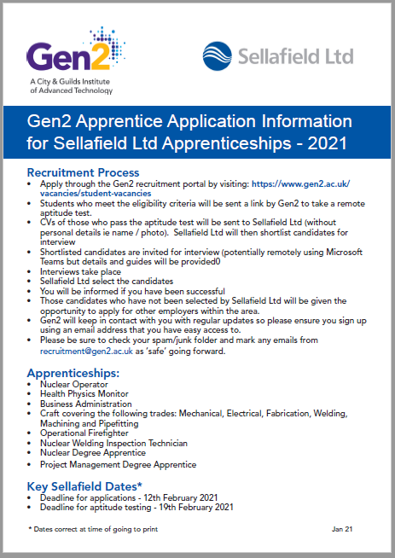
Sellafield Ltd Information
From November visit the Gen2 website for the Sellafield guide to applications:
Apprenticeships Typically Available:
^{Nuclear Operator}
^{Health Physics Monitor}
^{Business Administration}
Craft covering the following trades: Mechanical, Electrical, Fabrication, Welding, Machining and Pipefitting
^{Operational Firefighter}
Nuclear Welding Inspection Technician
^{Nuclear Degree Apprentice}
Project Management Degree Apprentice
Key Dates:
Deadline for applications - early February
Deadline for aptitude testing – mid February

Slide 22
Degree apprenticeship wages (Sellafield Ltd)
Example from 2021:

Slide 25
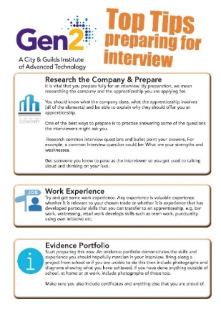
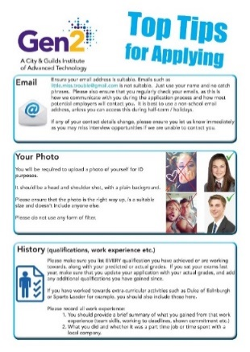
Tips for applying
Read the Gen2 Apprenticeship Guide and Top Tips
(copies available online from website or in print)
These guides and our website carry full, detailed information on the apprenticeships
If you have any queries – please ask!
Apply via our website – www.gen2.ac.uk

Slide 26
The Gen2 Application Process
Application process is online and covers:
Online application form (you will be provided with feedback)
Invited to aptitude testing
If you pass your aptitude test your CV will be put forward for consideration with employers
Employers select the candidates for interview
Interview will take place remotely or face to face
Candidates are informed of the outcome
Training will typically commence in September 2022

Slide 27
What should I do next?

Slide 29
What to do next …
Read the learner information available on our website
Attend our virtual or centre open evenings to ask questions
Email our recruitment team about any queries / entry requirements
Read your Top Tips and apprenticeship guide and decide what is best for you
COMPLETE YOUR APPLICATION and take your aptitude test
Within the deadline!

