Slide 1
MOOCs

Slide 2
Strategic choices and Unique insights
Easy access to and a direct comparison of the world’s best distance-learning courses all in one place.
Explore every option
An extensive list of subject areas gives you the opportunity to explore a university course prior to committing.
Expectations met
Unique filtering and ranking facilities enabling you to focus on key areas of interest.
The Benefits

Slide 3
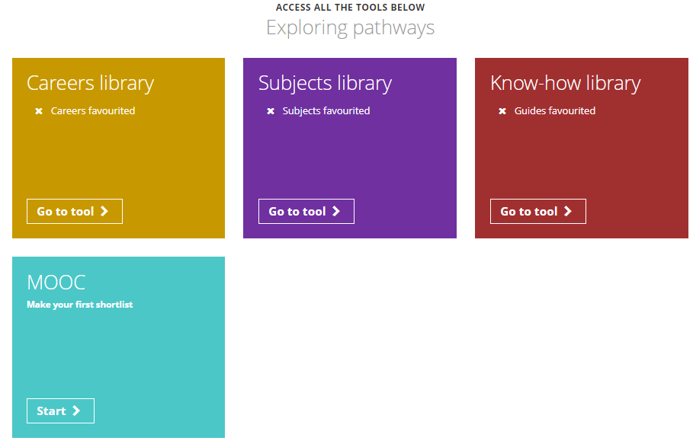
From the student dashboard at unifrog.org/student/home, click the ‘Go to tool’ button on the MOOC box.

Slide 4
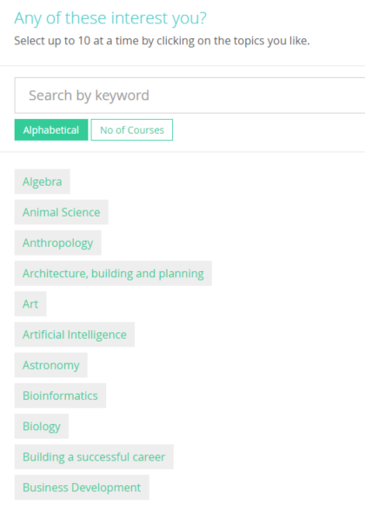
You will see a list of MOOC topics.
You can sort this list alphabetically or by the number of courses offered at the moment.
You can even search by particular career
(e.g. accountant/engineer) or interest by typing into search bar.
Select topics that interest you, up to a maximum of 10.

Slide 5
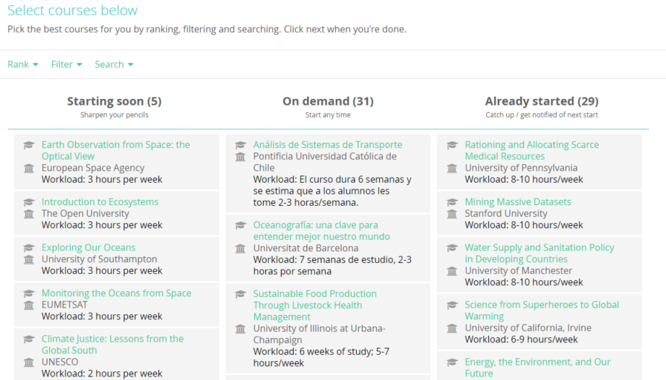
The Longlist page shows you all the current MOOCs for your chosen topics, sorted into three columns.
You can rank and filter courses to find the ones you’re most interested in.

Slide 6
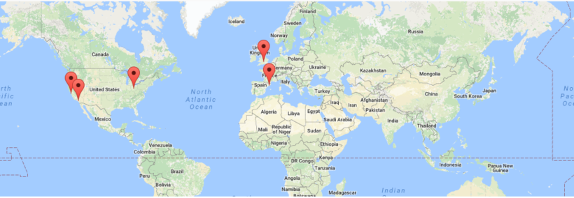
On the next page, the Shortlist, the map shows you the location of all the courses on a world map. These courses are all online so you don’t need to travel anywhere!

Slide 7
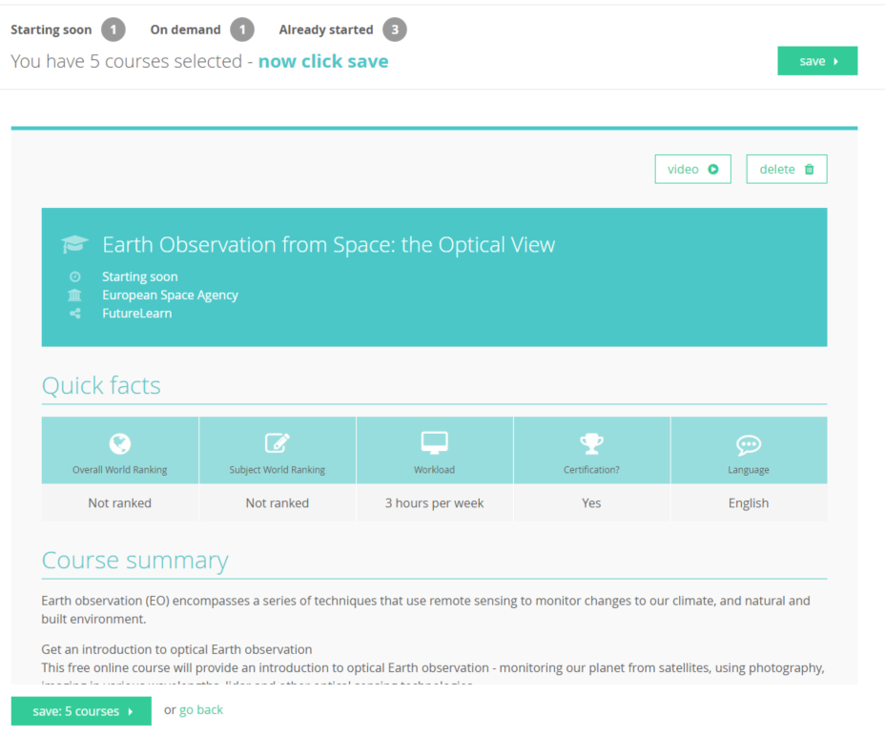
Scrolling further down the Shortlist page allows you to see lots of information about each course. Some have introductory videos.
At any point you can go back to the Longlist to add in more courses, and from the Shortlist page you can also delete courses.
Once you are happy with the MOOCs on your Shortlist, click save.

Slide 8
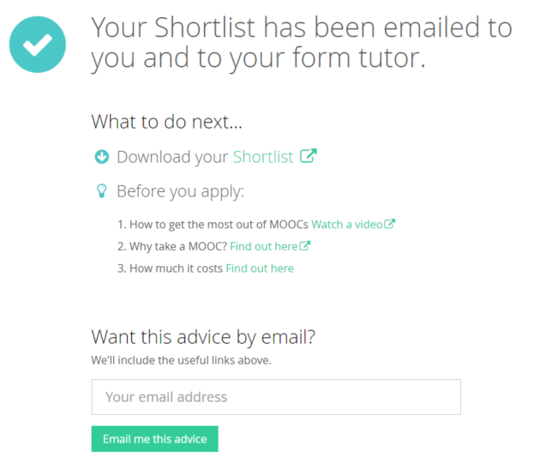
Afterwards, a copy of your Shortlist will be emailed to you and your tutor. Click here to view it straight away and then ‘Get started’ to begin the MOOC.
This page also shows you some handy links and more information about why you should consider taking a MOOC.

Slide 9
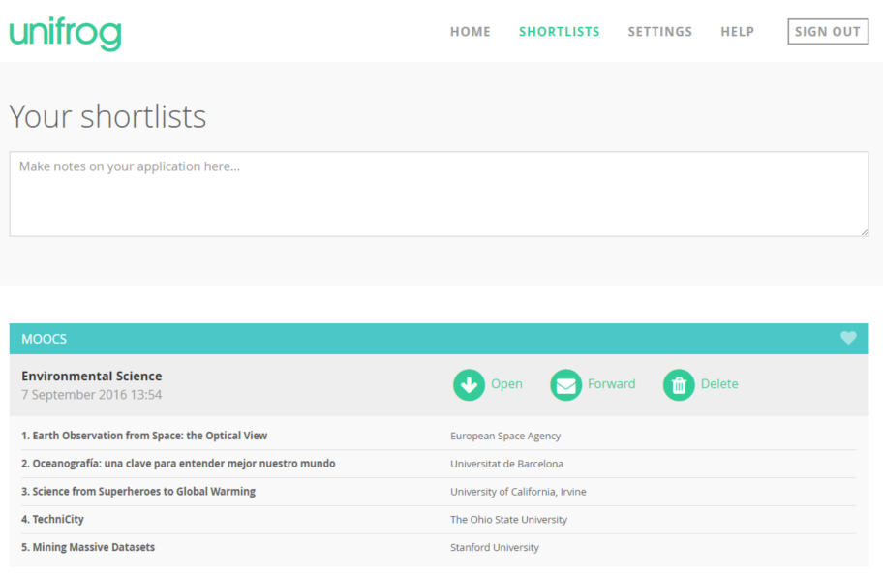
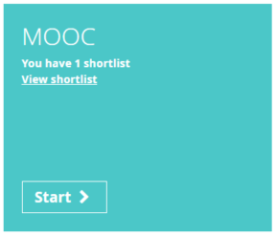
Remember, you can make as many MOOC Shortlists as you like and you can view them anytime by clicking on the Shortlist button on the main dashboard.

