Slide 1
CV / Resumé

Slide 2
The Benefits
Easy Recording
A template for creating your own unique, well-presented, well-structured and comprehensive CV.
Enhanced Applications
Significantly saves you time in writing and modifying your CV for targeting particular vacancies.
Heightened Employability and Career Prospects
Easily demonstrate your ability to communicate your suitability to potential employers

Slide 3
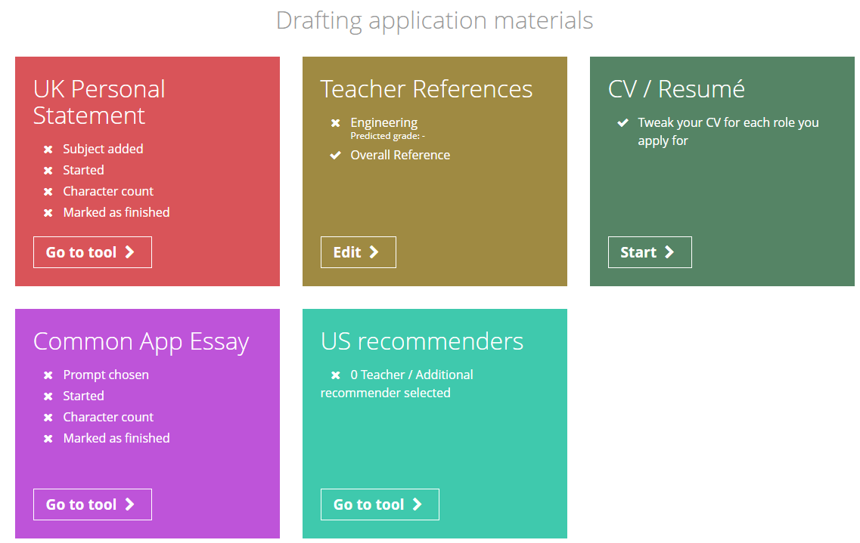
From the student dashboard at unifrog.org/student/home, click the ‘Go to tool’ button on the CV / Resumé box.

Slide 4
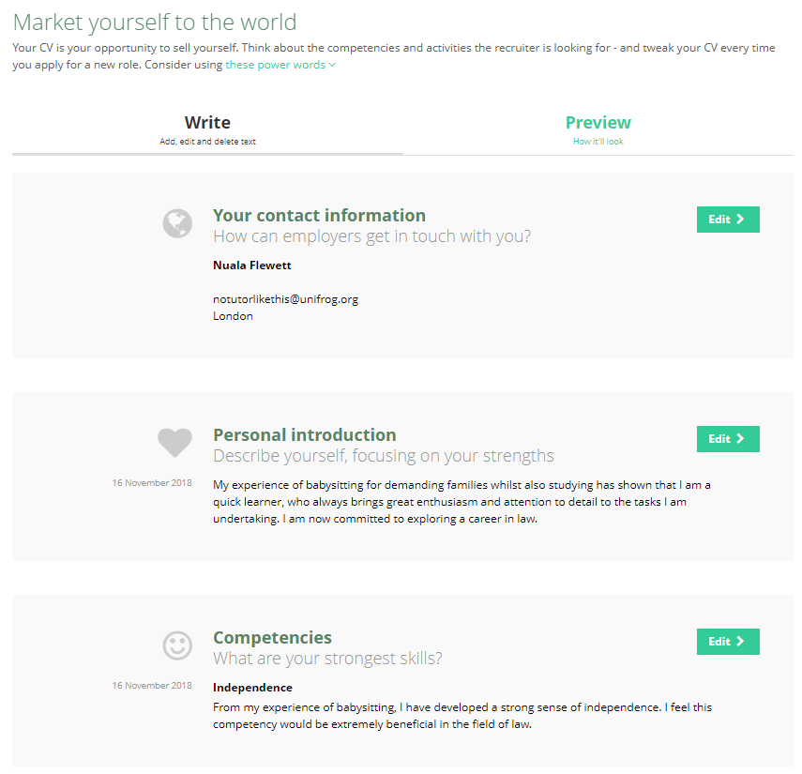
The tool is designed so that you can quickly update your CV whenever your circumstances change, and whenever you apply for a different role.
The CV is split into 5 sections. You can do these sections in any order and leave out any that you don’t want to include.

Slide 5
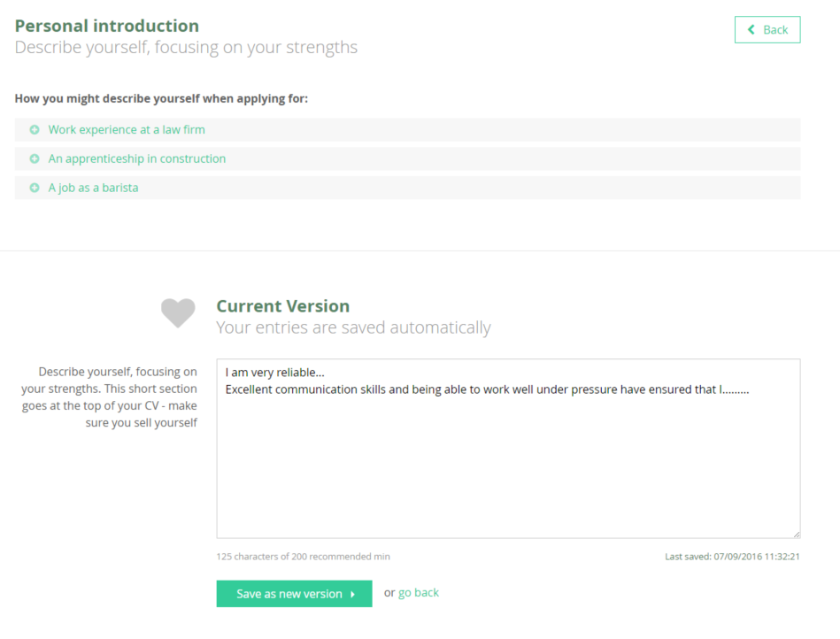
The personal introduction is a short statement that will go at the top of your CV. Type yours into this box.
Everything saves automatically, however always make sure to click ‘Save as new version’ when you’re ready.

Slide 6
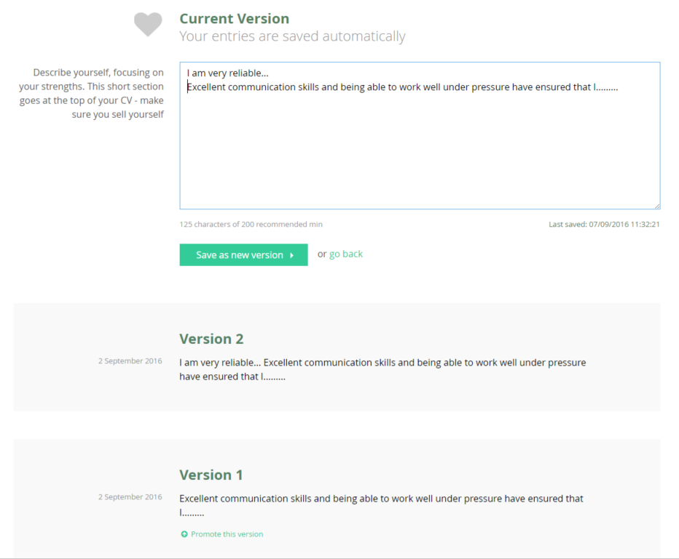
Only one version will appear on your CV. Choose an earlier version by clicking ‘Promote this version’.

Slide 7
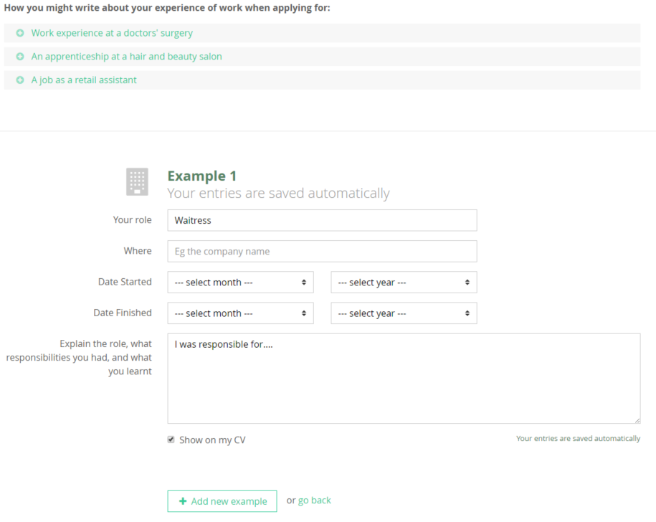
Continue filling the remaining sections in the same way.
You’ll see some examples at the top to get you started if you’re stuck. Don’t try to use these as templates; your entries need to be personal to you and the role you’re applying for.

Slide 8
It is essential to tailor your CV for different jobs so if you don’t want a particular example to appear on your CV then you can uncheck this box.
The unused example will stay saved on the tool so you can include it in another version of the CV if you want.

Slide 9
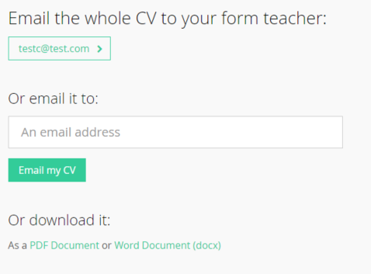
Click here to send your CV straight to your form teacher for them to check.
Type an email address here to send it to someone else. Please note that we do not recommend using this function to send it straight to employers, as you should send it from your own email account.
You can also download it as a Word or PDF document.

