Slide 1
Competencies

Slide 2
The Benefits
Easy recording
An easy template for recognising and recording solid examples that underline your personal experience, abilities and accomplishments.
Enhanced applications
Explores the Competencies used by employers in graduate recruitment.
Heightened employability/career prospects
Boosts your ability to prepare strong personal statements, CVs and applications for potential employers.

Slide 3
From the student dashboard at unifrog.org/student/home, click the ‘Go to tool’ button on the Competencies box.

Slide 4
There are twelve competencies that Unifrog have identified as being key.
You can add an example for each of these competencies.
To begin to complete your competency list, click the green ‘ + Add now’ button.
You can also add additional competencies of your own. Click ‘ + Add example’ to create an additional competency to add to your list.

Slide 5
To complete a competency select a situation and start date from the drop down menus.
Explain how you demonstrated this competency in detail.
If you need a structure to follow, use the star technique which is summarised on this page.

Slide 6
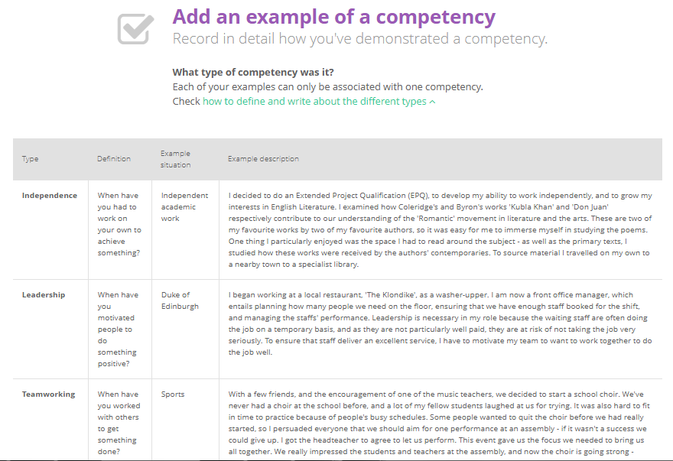
If you need help on what the competencies are or how to write about them then look at this handy table which you can expand by clicking on the green text.
Do not try to use these as templates; the entries need to be personal to you.

Slide 7
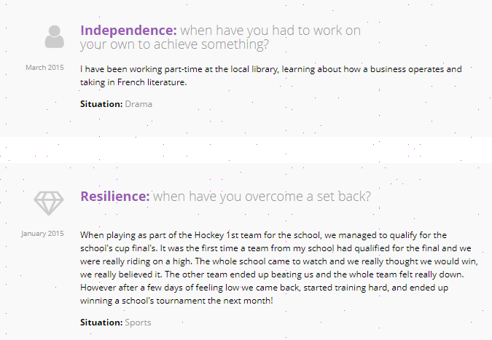
Repeat this process for each competency you want to add. You should try to do at least one for each category.

Slide 8
Your teachers are able to give you feedback on your competencies.
If you have received a comment you will be notified via your email and on your competencies page.
You are able to mark these comments as read to ensure you keep up to date.

Slide 9
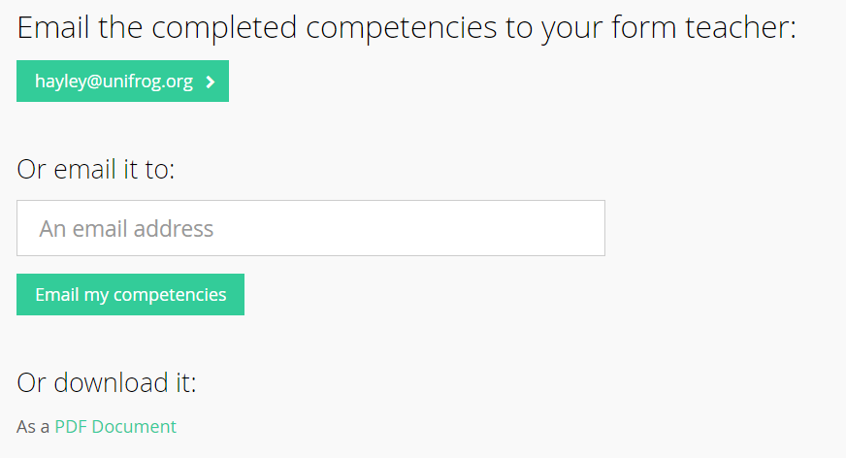
If you would like to share what you have written you can email it straight to your form tutor…
…or anyone else by typing their email in.
You can also download what you have written.

