Slide 1
Apprenticeship Opportunities Why Choose Sellafield Ltd.?

Slide 2
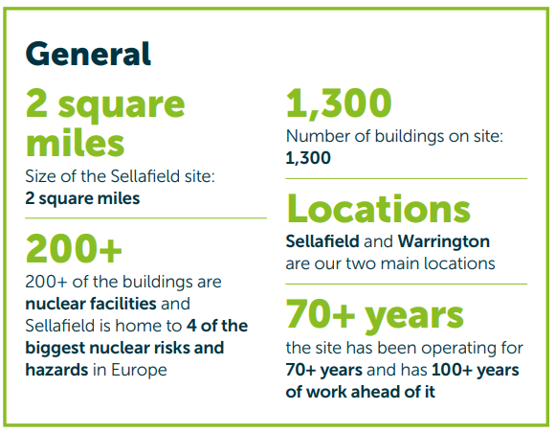
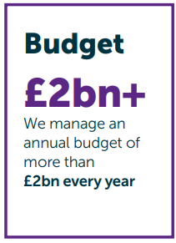
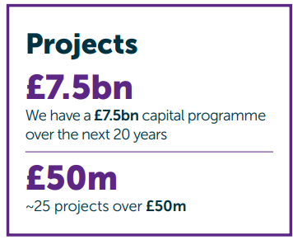
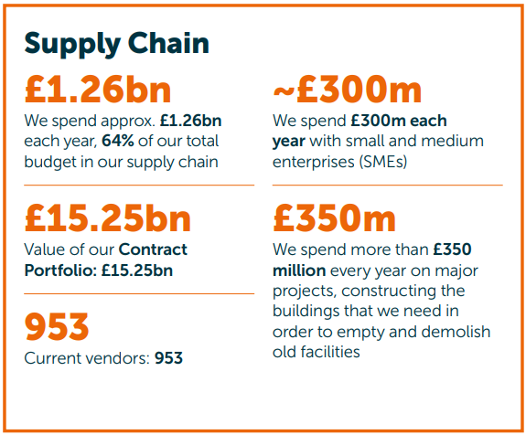
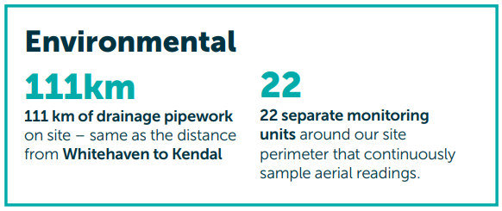
Sellafield Ltd by Numbers

Slide 3
Level 2 - 4 Apprenticeship Schemes
Business
Administration
Level 3
2 Years
Craft (including Fabricator, Machinist, Maintenance (Electrical & Mechanical), Welding)
Level 3
4 Years
Nuclear Welding Inspection Technician
Level 4
4 Years
Level 2
2 Years
Nuclear Operator
Level 2
2 Years
Health Physics Monitor

Slide 4
Level 2 - 4 Apprenticeships – Entry Requirements
Craft, Health Physics & Nuclear Operator
Minimum of 3 GCSEs Grade 4 (Grade C) in Mathematics, English Language & one Science, or Engineering subject, or equivalent (e.g. Functional Skills Level 2).
Business Administration
Minimum of 3 GCSEs Grade 4 (Grade C) in Mathematics, English Language & 1 Science/Engineering subject OR ICT subject (Business Studies, ICT Level 2, BTEC Level 2, Higher ECDL or similar) or equivalent (e.g. Functional Skills Level 2).
Nuclear Welding Inspection Technician
Minimum of 5 GCSEs at Grade 4 (Grades A to C) including 1 Science or Engineering subject or equivalent (e.g. Functional Skills Level 2) & Mathematics and English Language at Grade 5 (Grade B) or above.
Age requirements for Health Physics (must be 18 by start date) and Nuclear Operator (must be 18 by February 2024)

Slide 5
Level 5 - 6 Apprenticeship Schemes
Digital Technology Solutions
Scientific
Technical
Quality
Construction
Commissioning
Civil Asset Management
Project Management
Operations
Plant Engineering
Control Systems
Safety Case
Engineering Design

Slide 6
Structure of a Degree Apprenticeship
All Degree apprentices will complete a bridging course (currently 17 weeks) delivered at one of our local training providers which you need to pass to pass your probation.
Apprentices will then be based full time in the workplace and continue academic studies on a day release basis at one of our local training providers.
Phase 1 – initial 3-year period: • Nuclear Technician Apprenticeship Standard (Level 5); • Foundation Degree/HND (Level 5) in either a science or engineering-based discipline
For candidates with the ability to progress further: Phase 2 – further 2 year period: • Nuclear Scientist and Engineer Integrated Degree Apprentice Standard (Level 6); • Bachelor’s Degree in Engineering (BEng – Level 6) or a Bachelor’s Degree in Science (BSc – Level 6) aligned to your career pathway

Slide 7
Entry Requirements – L5 – L6
Minimum of 5 GCSEs at Grades 9 to 4 (Grades A* to C) including Mathematics, English Language and one Science or Engineering subject.
Minimum of 96 UCAS points at A-Level, STEM subjects preferred (e.g. Mathematics, Chemistry, Biology, Physics or Science) but not mandatory.
Other Level 3 STEM qualifications may be considered.
Vocational equivalents at level 3 or higher will also be considered as equivalent to UCAS points.
If you do not have Mathematics at A Level then you must achieve a minimum of Grade 6 (Grade B) at GCSE (*not for Project Management).

Slide 8
Why Choose Sellafield Ltd.?
Salary We offer a competitive salary, with a pay increment each year. Exact salaries can be found on our website!
Pension Scheme An attractive defined contribution pension scheme – up to 13.5% Employer Contribution.
Lifestyle Benefits SASRA exists to provide sporting, social and recreational facilities and opportunities for its members.
Annual Health Check Free Aviva Health App & Annual Health Check
Annual Bonus Scheme Benefit from a bonus of up to £4,000*, based on Company Performance.
Holiday Allowance 25.5 days annual leave, plus 8 bank holidays – there is also the option to purchase an additional 3 days, and carry-over 5!

Slide 9
Sellafield Ltd. Application Process
Applications through SL careers website
Application Review
Online Values & Strengths based situational judgement assessment
Interviews
March 2024
Final Selection
Conditional Offers
Results / confirmations / clearing
Start Date: Expected September 2024

Slide 10
Application Tips
DO YOUR RESEARCH
As part of your application, you will be able to pick your preferred schemes. If you select a scheme, ensure you have researched it and have reasons of why you are interested in each scheme.
TAKE YOUR TIME
Take care when you are completing your application, attention to detail is important. Make sure you include ALL your qualifications and predicted grades.
PLAY TO YOUR STRENGTHS
We want to know about you, be truthful and tell us about your experiences, whether that be from school or work, and apply it to working at Sellafield Ltd.

Slide 11
Key Dates
Our Apprenticeship Event - Energus:
11th November 2023
Go Live:
6th November 2023
Applications Close:
11th February 2024
Interviews:
March 2024
Start Date:
September 2024

Slide 12
Any Questions

