Slide 1
College and Sixth Form

Slide 2
The Benefits
Strategic choices and unique insights
A uniquely comprehensive live feed of college courses in the UK.
Enhanced research
Significantly speeds-up and supports your research, allowing a direct comparison on courses on 25+factors.
Expectations met
Unique filtering and ranking facilities enabling you to focus on key areas of interest.

Slide 3
From the student dashboard at unifrog.org/student/home, click the ‘Start’ button on the College / Sixth Form box.

Slide 4
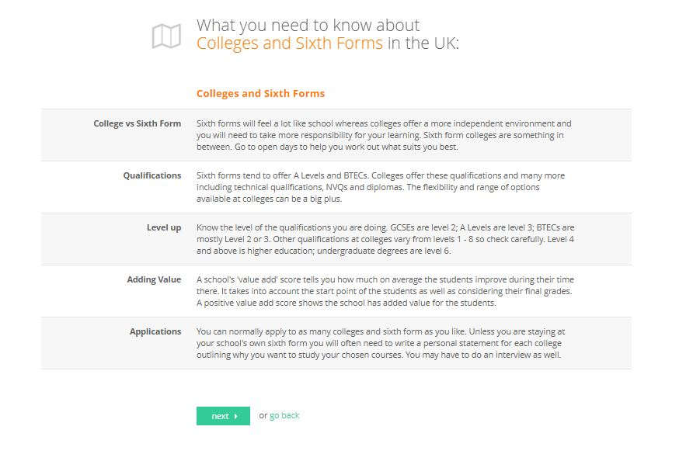
You can familiarise yourself with important details about College and Sixth Forms.
It’s important to take these into consideration when searching for your desired courses.
Once you are ready to begin your course search, click ‘next’ at the bottom of the page.

Slide 5
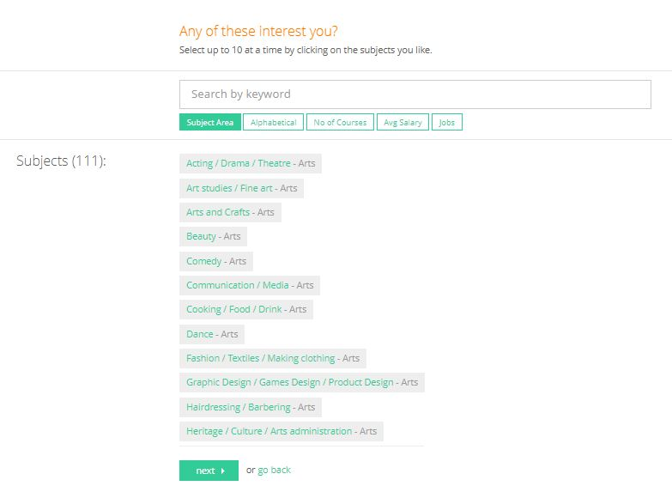
Here, you will see a list of subjects.
You can sort subjects alphabetically, by subject area as well as other factors!
You can also look for a specific subject or course you’re interested in by using the search bar.
Select up to a maximum of 10 subjects and press Next.
Notes:
Change 2nd paragraph – lists

Slide 6
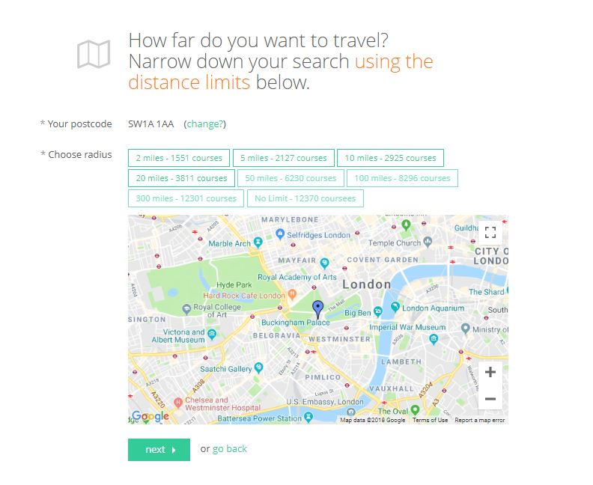
You will be asked to narrow down your search using the distance limits.
Distance is measured via mile radius, which is shown on a map and your location will be identified to you as a blue pin.
Once you select the radius you wish to view courses in, click ‘next’ at the bottom to continue.

Slide 7
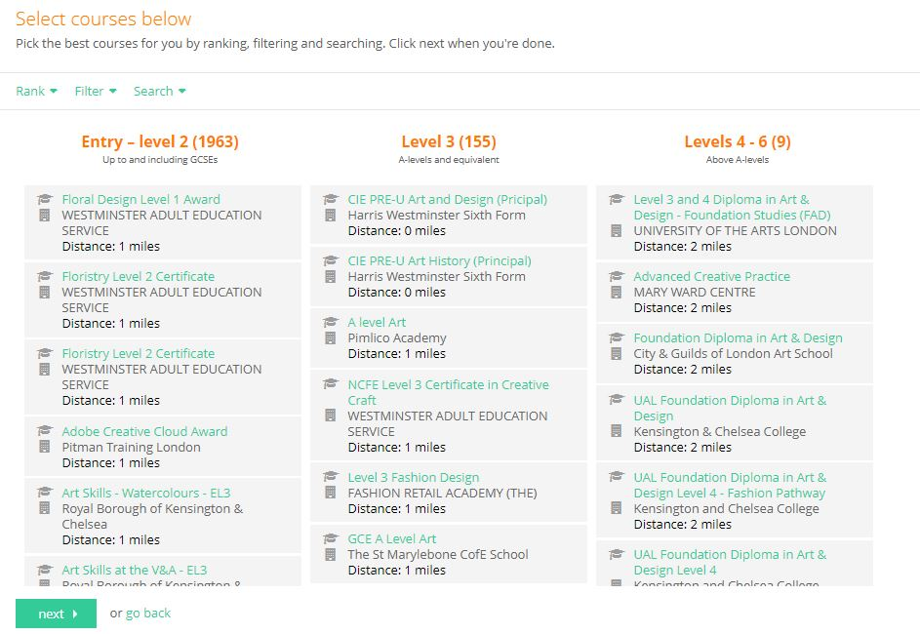
The Longlist page shows you current courses for your chosen topics, sorted into three columns.
You can rank and filter courses to find the ones you’re most interested in.

Slide 8
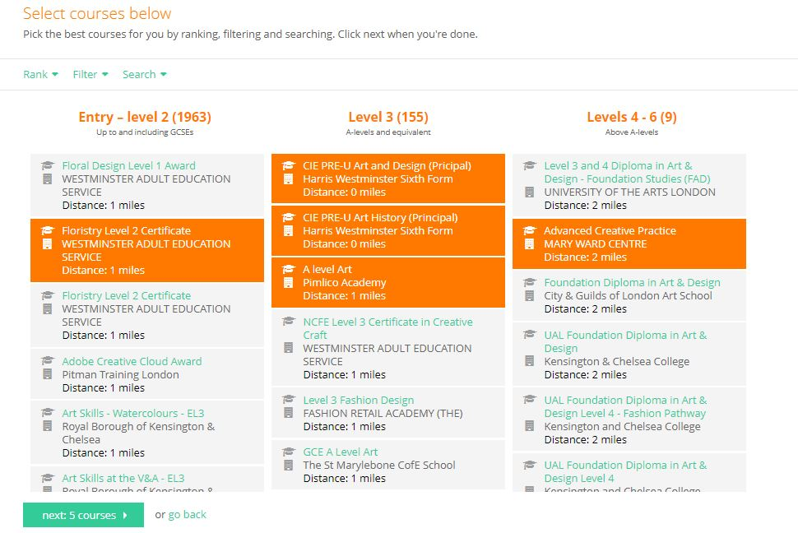
Once you have selected your desired courses, press ‘next’, which will add them to your shortlist.

Slide 9
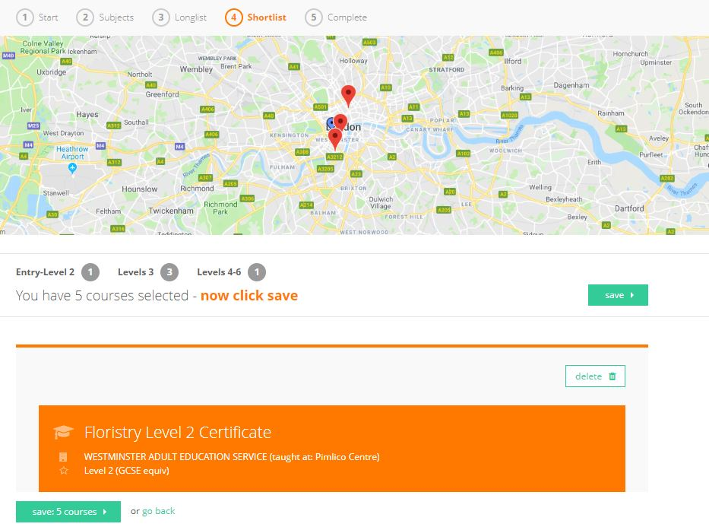
The Shortlist collates your selected courses into one list.
You will be shown a map at the top of the page, with red pins indicating the location of where the courses will be held.
You can click on a red pin, which will take you straight to the course on your shortlist.

Slide 10
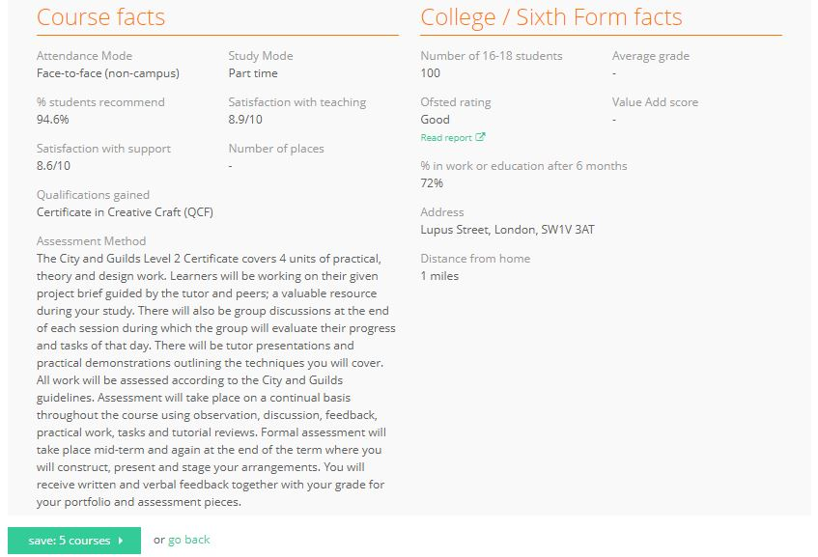
From the shortlist, you can find a summary of each course you’ve selected, including entry requirements, key dates and college/sixth form facts! You can also delete courses from the shortlist if you wish to.
Once you’re happy with the courses on your shortlist, press ‘save: ’.

Slide 11
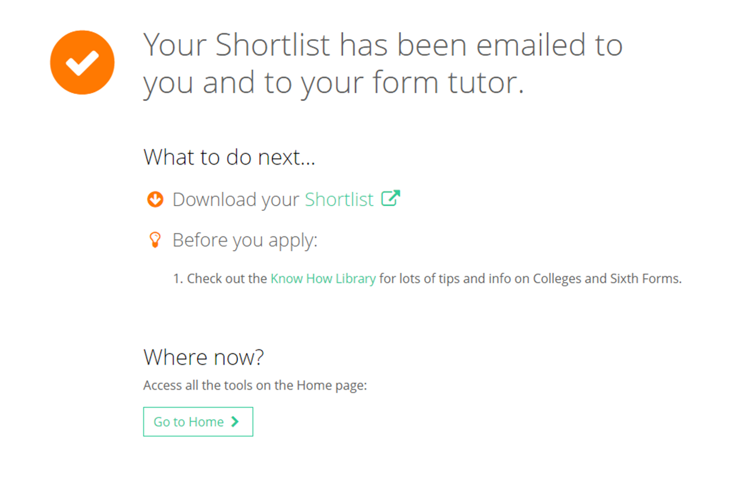
Afterwards, a copy of your Shortlist will be emailed to you and your tutor will also be able to access it. Click here to view it straight away.
This page also shows you some handy links, including information on funding.

Slide 12
Remember, you can make as many College / Sixth Form Shortlists as you like, and you can view them anytime by clicking on the Shortlist button on the main dashboard.

