Slide 1
Activities

Slide 2
The Benefits
Competency Confirmed
An easy template for recording solid examples of activities that underline your personal experience, abilities and accomplishments.
Clarity
A clear template as well as hints, tips and guidance.
Applications Enhanced
Explore the competencies used by employers in graduate recruitment and store an extensive range of material.

Slide 3
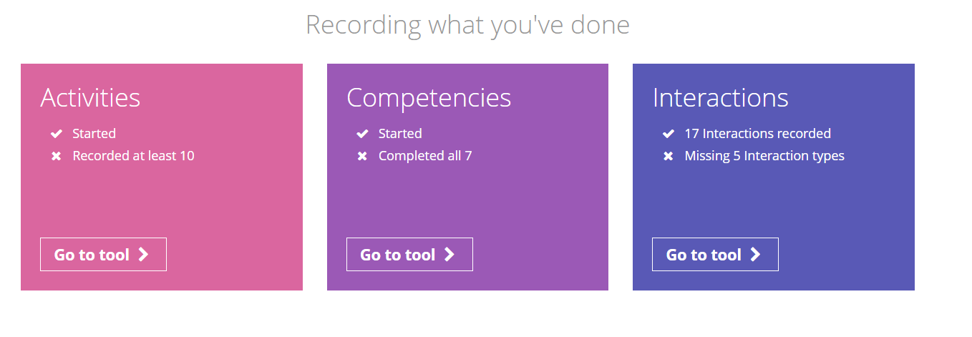
From the student dashboard at unifrog.org/student/home, click ‘Go to tool’ on the Activities box.

Slide 4
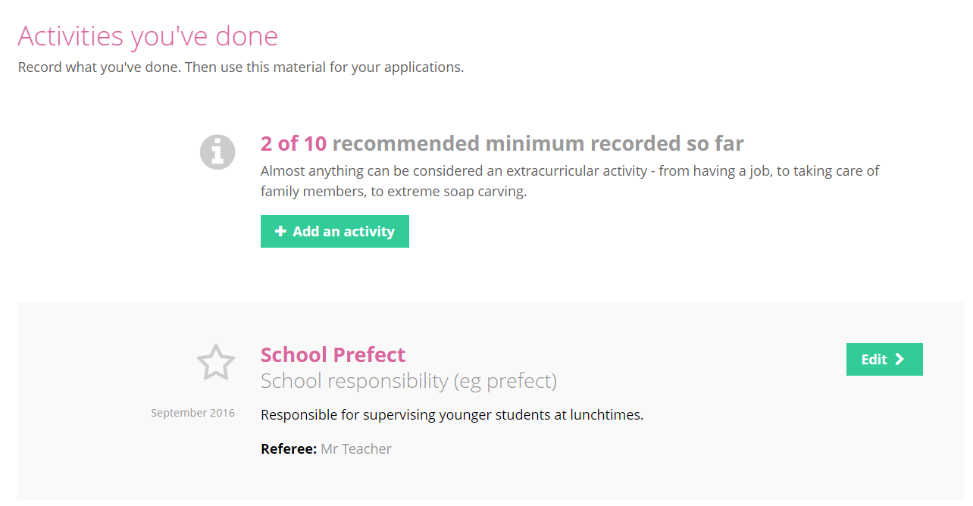
To begin, click on ‘Add an activity’ to take you to the template for recording your example.

Slide 5
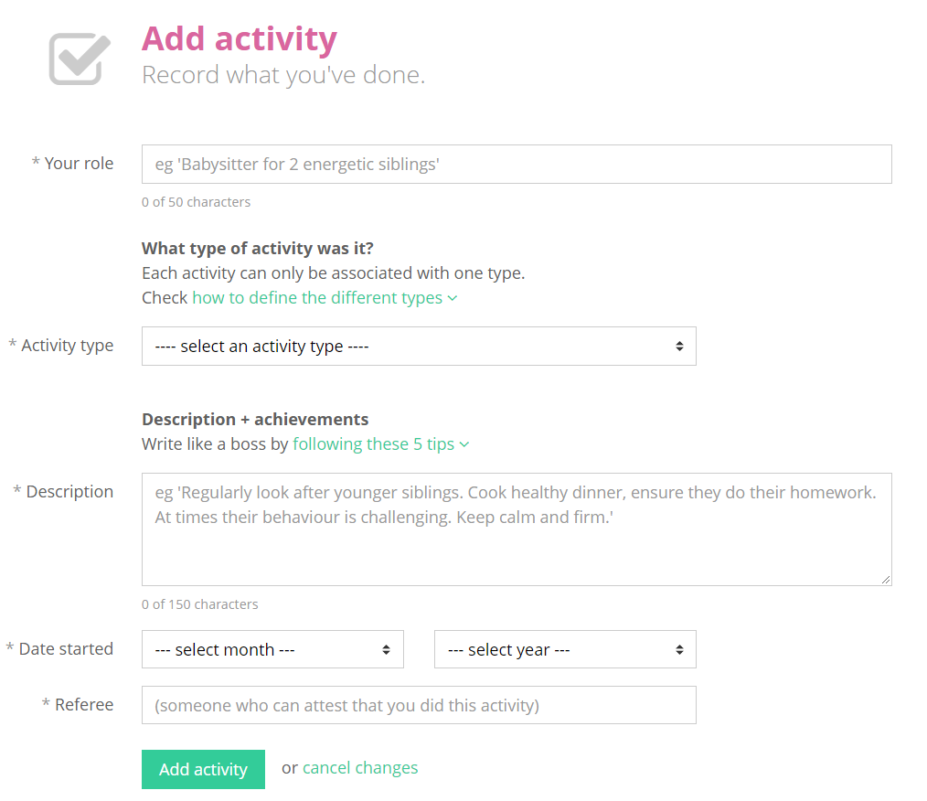
To complete an activity, state your role and select an activity type from the drop down menu.
If you are unsure how to define the type of activity, you can use the guide to help you.

Slide 6
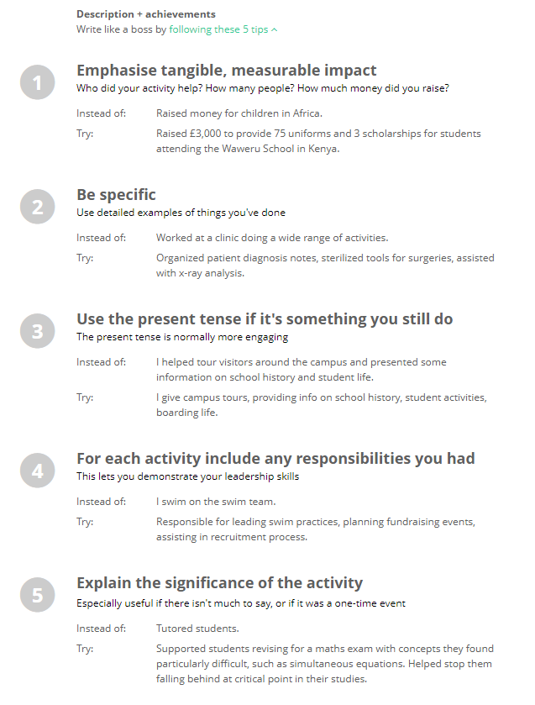
Then you need to write the description.
If you need them, there are tips on how to describe your examples expertly.
Please note: do not try to use these as templates; the entries need to be personal to you.

Slide 7
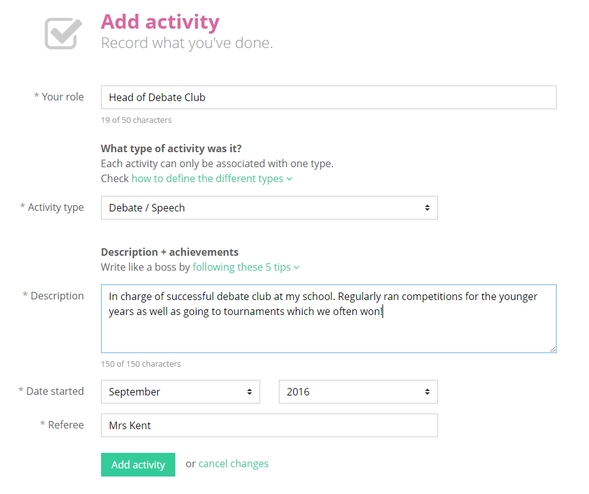
Once completed, click on ‘Add activity’ at the bottom of the page.

Slide 8
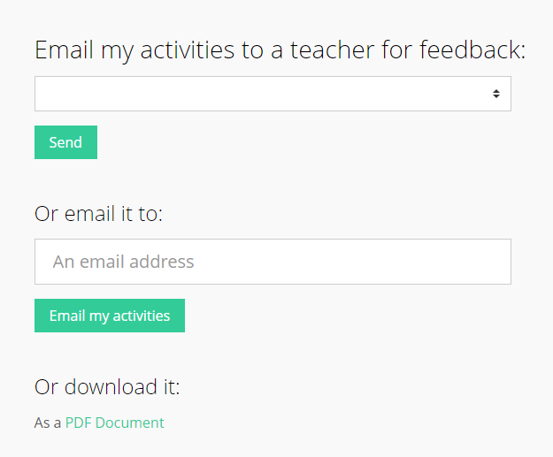
If you would like to share what you have written, you can email it straight to a teacher by selecting them from the drop down list.
…or anyone else by typing in their email address.
You are also able to download what you have written.

