Slide 1
P16 Intentions

Slide 2
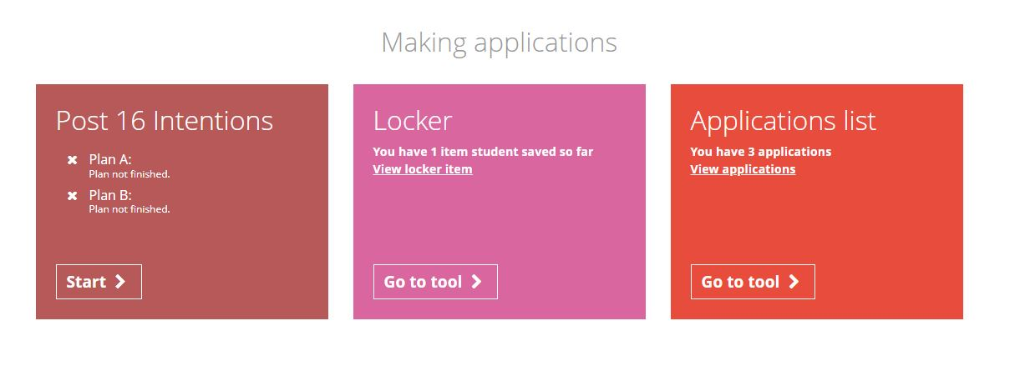
From the student dashboard at unifrog.org/student/home, click on the Post 16 box under the ‘Making applications’ subheading.

Slide 3
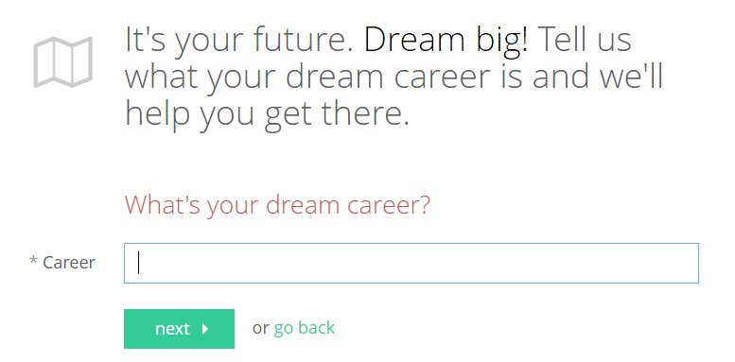
It’s time to type in your dream career!
Keep it short and simple and remember you can change this at anytime.
If you’re not sure, you can just type in ‘Not sure’ and press ‘Next’.
Notes:
If youere not sure, justtype in not sure

Slide 4
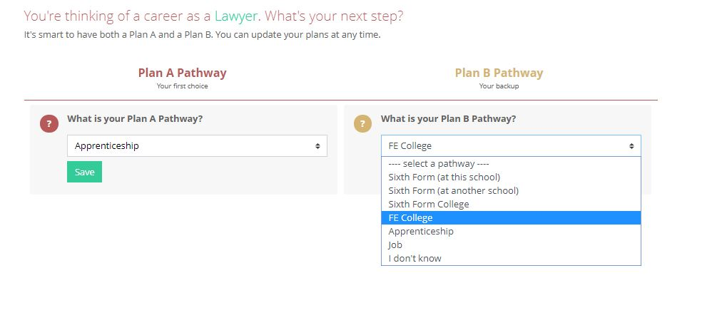
Work your way through the boxes to create your Plan A and Plan B pathways.
Make sure you press Save!

Slide 5
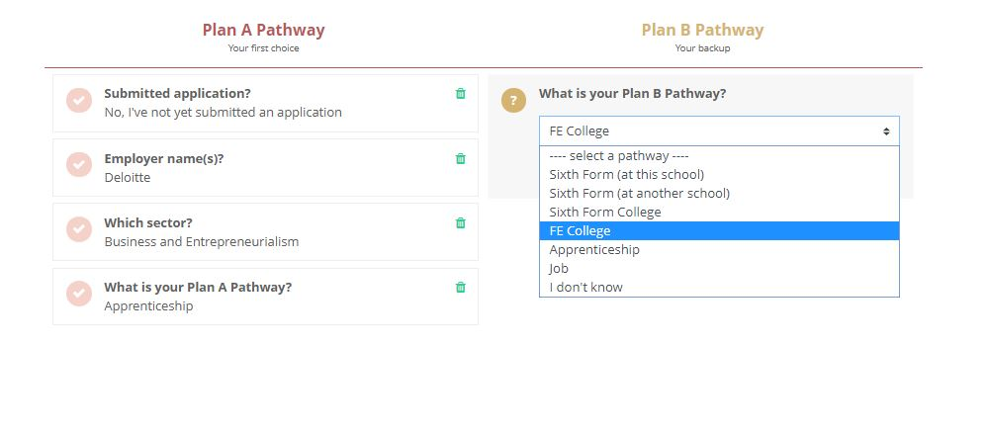
You can change any of the options at anytime by clicking on the dustbin next to each box.
Notes:
Add first stages

Slide 6
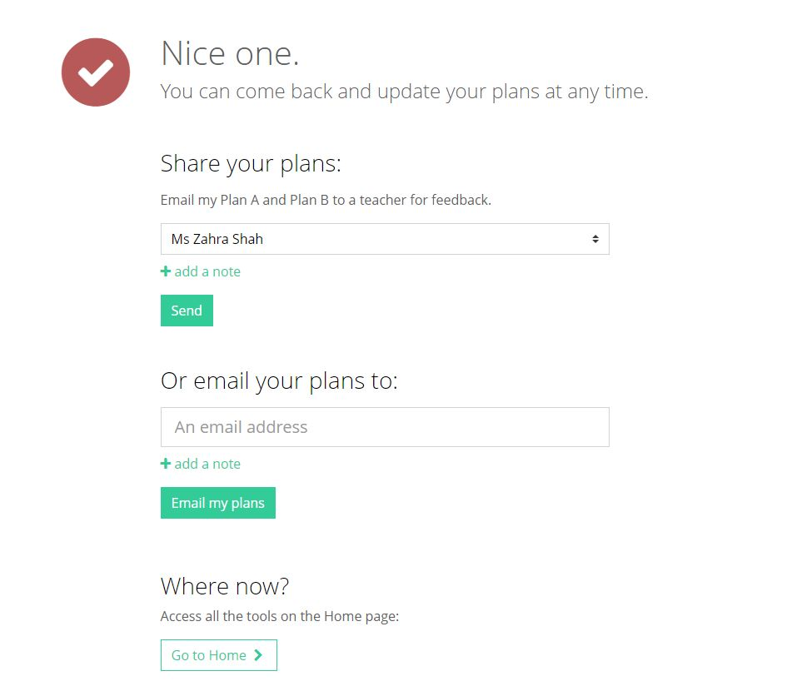
Click ‘next’ when you are done and you will complete the tool - you can update this at anytime.
You can share your plans with your form tutor or type in another email address.
You can also attach a note to the person you’re emailing.

