Slide 1
Locker

Slide 2
The Locker can be used to store items that will support your applications, such as photos, videos, certificates and so on, but it can be for almost anything you that you would like your teachers or counsellors to take a look at.
To get started, go to the student dashboard at unifrog.org/student/home and at the top of the page, click on Locker.

Slide 3
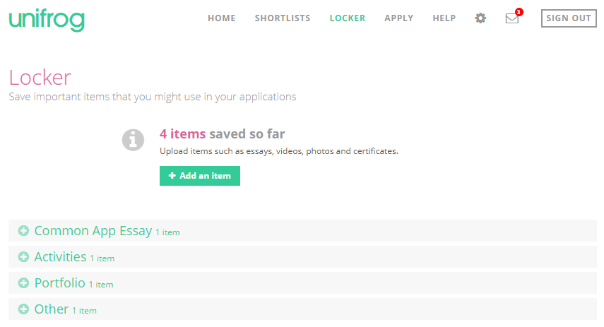
To add to your Locker, click ‘+ Add an item’.

Slide 4
There are five different ways you can add an item to the locker. First of all, you can use the file picker to select a document from the device you are using.

Slide 5
Secondly, you can upload a document or image directly from Dropbox or Google Drive. You will need to login to the relevant account to access the files.

Slide 6
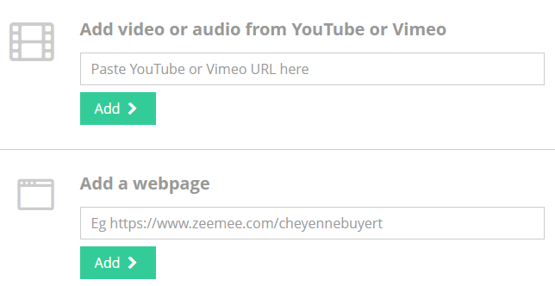
Alternatively, you can add in the URL of a video from YouTube or Vimeo, as well as a piece of audio from YouTube or Vimeo. Even the URL of a webpage can be stored for future reference.

Slide 7
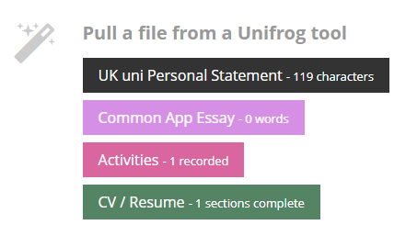
You can also pull a file from a Unifrog tool that you have already used – this can be the Personal Statement tool, the CV tool, and so on.

Slide 8
Once you have uploaded your item, it will appear as a thumbnail.
You will need to add in the Item type, Item title, and any notes. If you have pulled the item from another Unifrog tool, the item type will already have been selected for you.
You can always cancel if you wish to do so, or delete your version entirely.
When you’re done, click ‘Add item’.

Slide 9
You can find all your saved items at the bottom of the Locker page, and you can click on the item type to expand them. Once expanded, you have the option to ‘Edit’, ‘Upload a new version’, or ‘Request feedback’ from a teacher or counsellor.
If you do choose to request feedback, you will see a dropdown box with your teachers’ names, and there will be space for you to add a message. Select the correct one, type in your message, and hit ‘Send’.

Slide 10
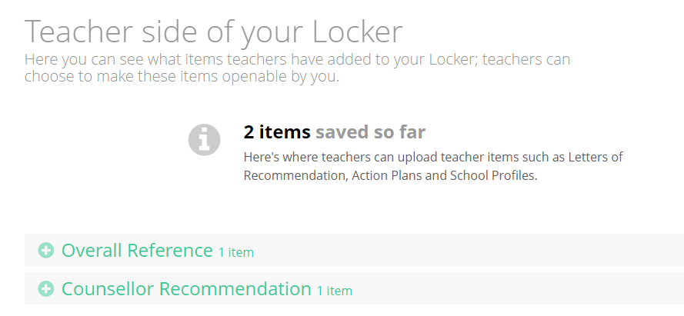
There is also a teacher side of the Locker where you will be able to see how many items been added to your Locker by a teacher.

Slide 11
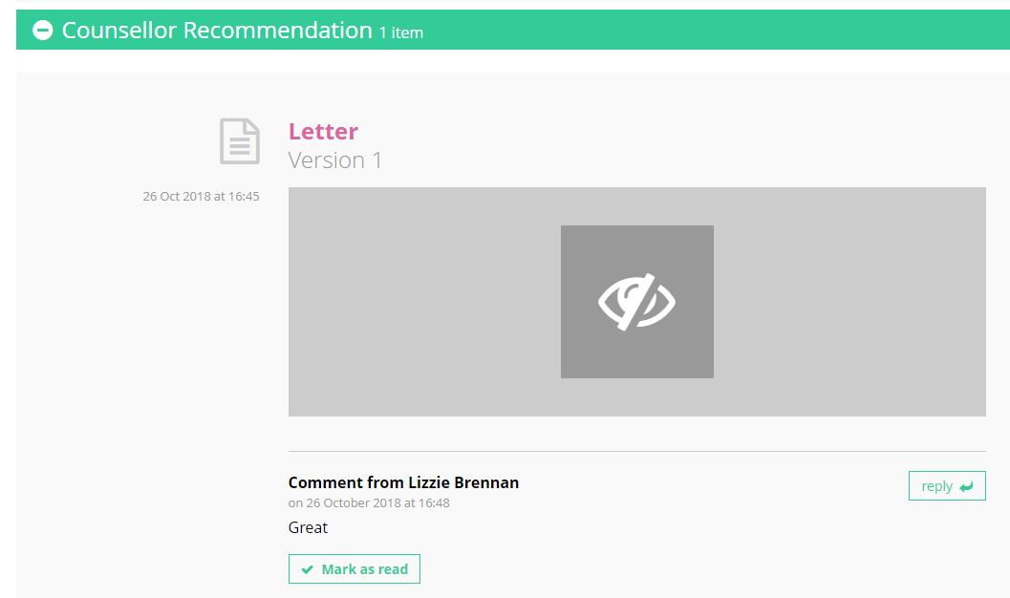
Teachers can decide to make these items openable by you. However, if they do not, you will only be able to see the format of these items in your Locker, but not the actual item itself.

Slide 12
You can view any comments which they have left by teachers on these items, mark them as read and also reply to the comment.

Slide 13
FAQs
Q. Can I delete an item from the locker once it has been uploaded?
Yes, you can do this by clicking ‘edit’ on the item, then at the bottom of the next page, click ‘delete this version’. This will then take you to a page which says, ‘are you sure you want to delete this version?’. Please note that deleting is irrevocable.
Q. Can teachers add items to my Locker too?
Yes! Students will also be able to see what items teachers have added to their locker, but only be able to view the item if it has been made openable by the teacher.

Slide 14
FAQs – Continued
Q. How do I associate items in my Locker to my Applications List?
Click on ‘APPLY’ from your homepage and go to the application you wish to add an item for. From the Student items tab, click ‘Add an item’ to view all the items you have added to your Locker.

